Slide 1
INSPIRE model: classic
[C] [0..n] CoupledResource
[?] ResourceLocator
[M] ResourceLocator
Service MD
Service GetCap
Dataset MD
[M] ExtCap/SpatialDatasetIdentifier
[?] ExtCap/metadataURL
collection
Data (Layer/Feature)
[?] metadataURL

Slide 2
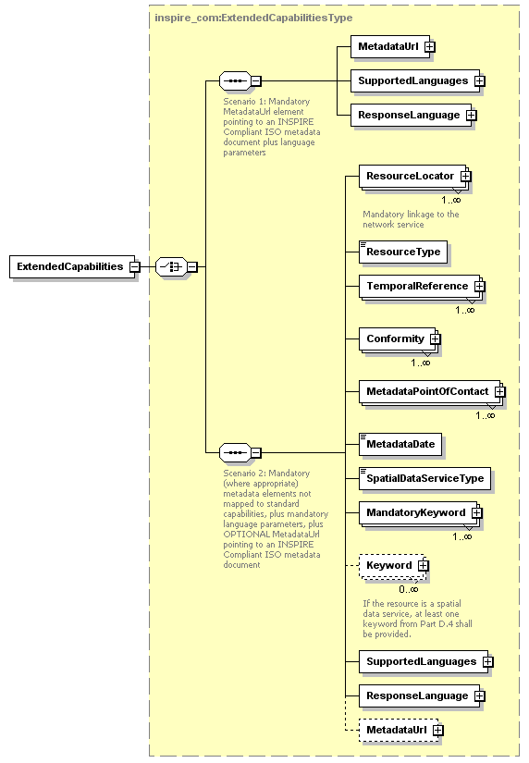
INSPIRE model: classic
Service Metadata: Scenario 1
Service GetCap
Service MD
[M] ResourceLocator
ExtendedCapabilities
[size=3]
[M] inspire_common:MetadataURL

Slide 3
INSPIRE model: classic
In the VW TG, the existence of the service MD is mandatory, regardless of the choosen scenario (1 or 2). It means a simple duplication of information between the service and its metadata
Service Metadata: Scenario 2 (based on VW TG)
Service GetCap (+)
Service MD
[M] ResourceLocator
ExtendedCapabilities
[size=n]
[O] inspire_common:MetadataURL

Slide 4
INSPIRE model: classic
In the DW TG, the existence of the service MD is NOT mandatory. It means that scenario 2 suggests you can avoid the creation of service MD, if you enrich the service itself with MD information.
Service Metadata: Scenario 2 (based on DW TG)
Service GetCap (+)
Service MD
[M] ResourceLocator
ExtendedCapabilities
[size=n]
[O] inspire_common:MetadataURL

Slide 5
INSPIRE model: simplified
[M] ResourceLocator
Service MD [O]
Service
MD Response (+)
Dataset MD
[O] ExtCap/SpatialDatasetIdentifier
collection
Data (Layer/Feature)
[M] metadataURL
Legend:
Service MD Response (+): refer to an INSPIRE Network Service – Scenario 2 implementation
[M]: mandatory
[O]: optional

Slide 6
INSPIRE model: simplified
Service Metadata: single scenario
Service GetCap (+)
ExtendedCapabilities
[size=n]

